Slide 1
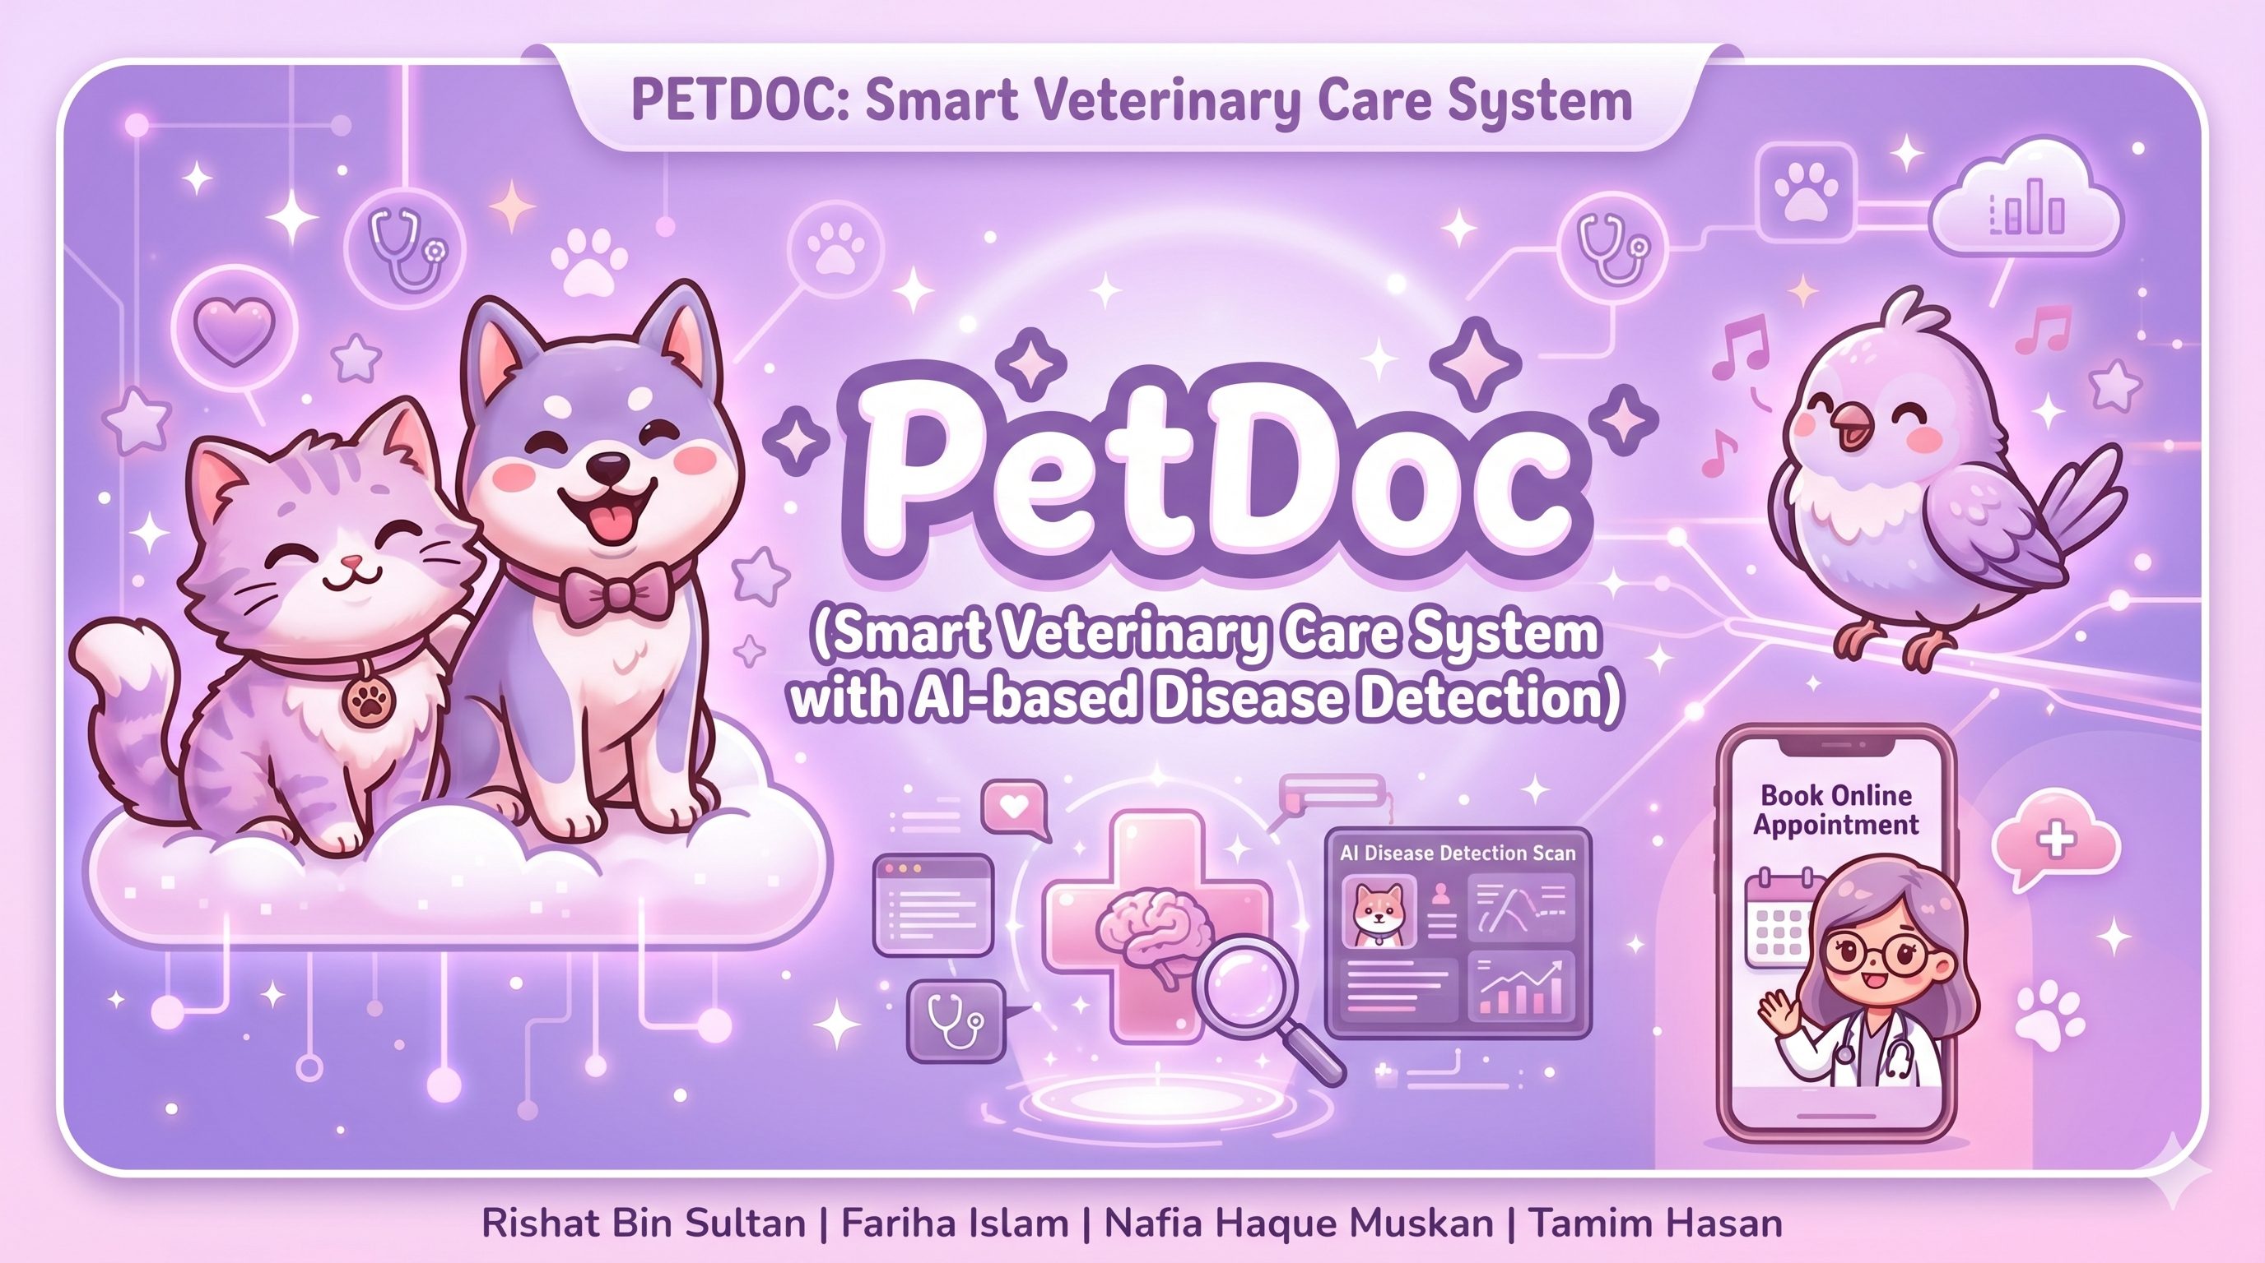

Slide 2
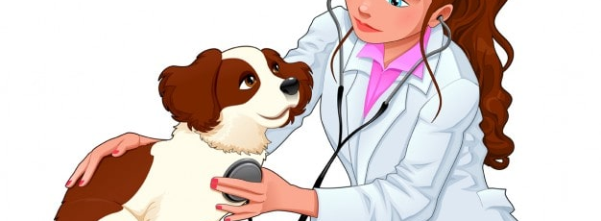

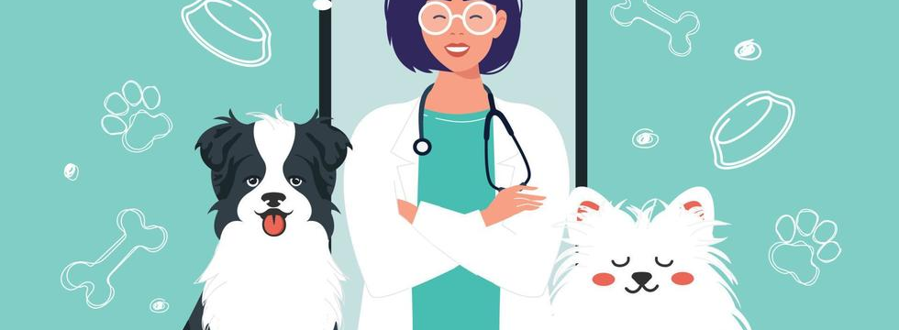
Project Overview
AI Disease Detection
E-Commerce Platform
24/7 Consultation
Gemini-powered symptom analysis & image classification for preliminary disease guidance
Full-featured veterinary marketplace with cart, wishlist, orders & payment
Online veterinary appointments with 5 specialist doctors
Text Input
Image Upload
5 Specialists
Booking System
Urgency Assessment
Product Catalog
Cart & Checkout
Reviews
Email Notifications
Tech Stack: Django • Google Gemini AI • PIL • PostgreSQL • Bootstrap
Group 05 | Rishat Bin Sultan, Fariha Islam, Nafia Haque Muskan, MD Tamim Hasan

Slide 3
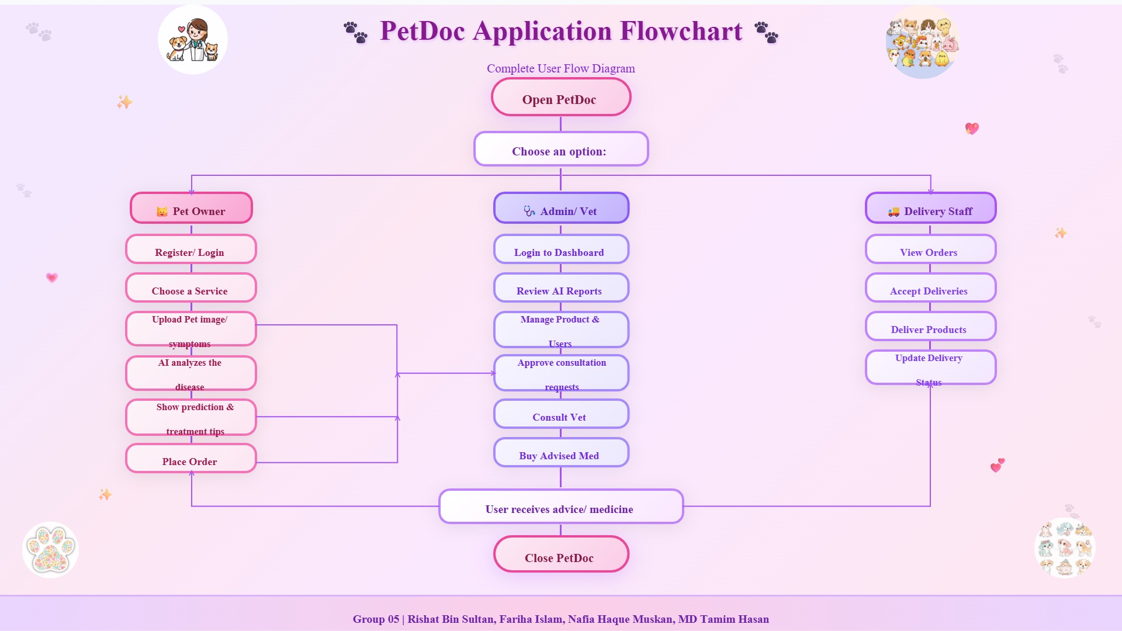

Slide 4
Database Schema & Models
11 Django models with complex relationships
Vendor
CartItem
Review
OneToOneField → User
name, email, phone, address, image
FK → Cart, Product
quantity, get_total()
FK → Product, User
rating (1-5), comment
Category
Wishlist
PaymentMethod
Auto-slugify via save()
title, slug, image
OneToOneField → User
ManyToManyField → Product
FK → User
card_number, card_name, expiry_date
masked_number() method
Product
Order
Address
FK → Vendor, Category
title, slug, price, stock, label
avg_rating, review_count
FK → User
total_amount, status (5 choices)
Pending → Processing → Shipped → Completed → Cancelled
FK → User
title, address_line, city, state
postal_code, country, is_default
Cart
OrderItem
Appointment
OneToOneField → User
created_at
FK → Order, Product (SET_NULL)
quantity, price (snapshot)
email, doctor (5 choices)
created_at
Relationship Types: OneToOneField (3) • ForeignKey (6) • ManyToManyField (1) • SET_NULL (2)
Group 05 | Rishat Bin Sultan, Fariha Islam, Nafia Haque Muskan, MD Tamim Hasan

Slide 5
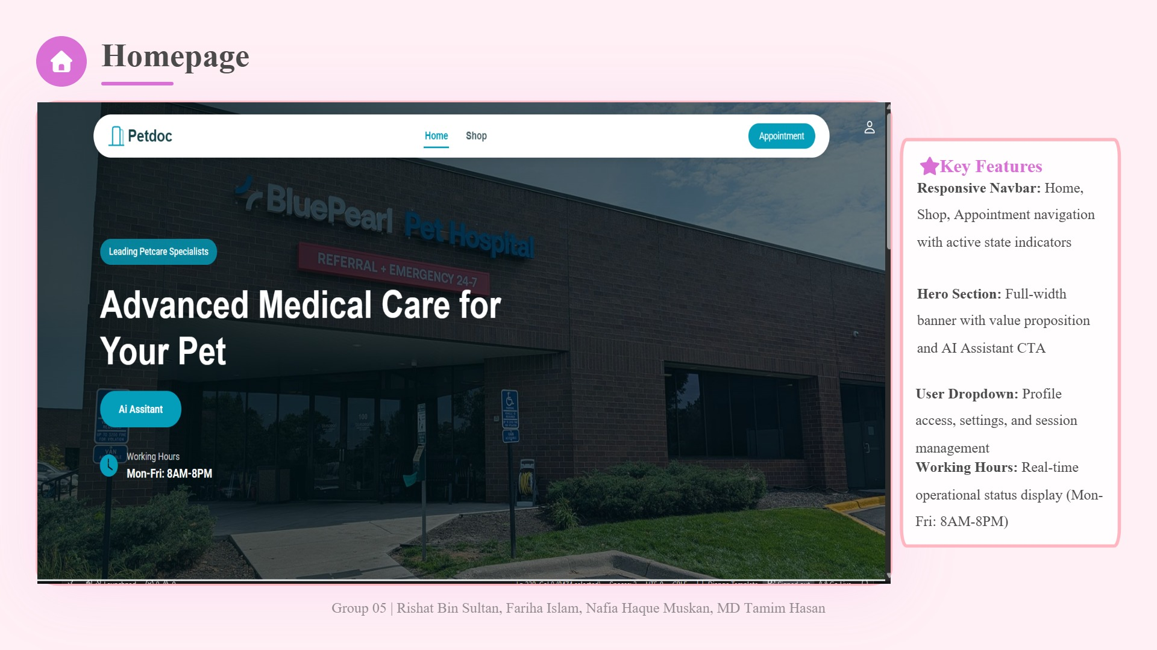

Slide 6
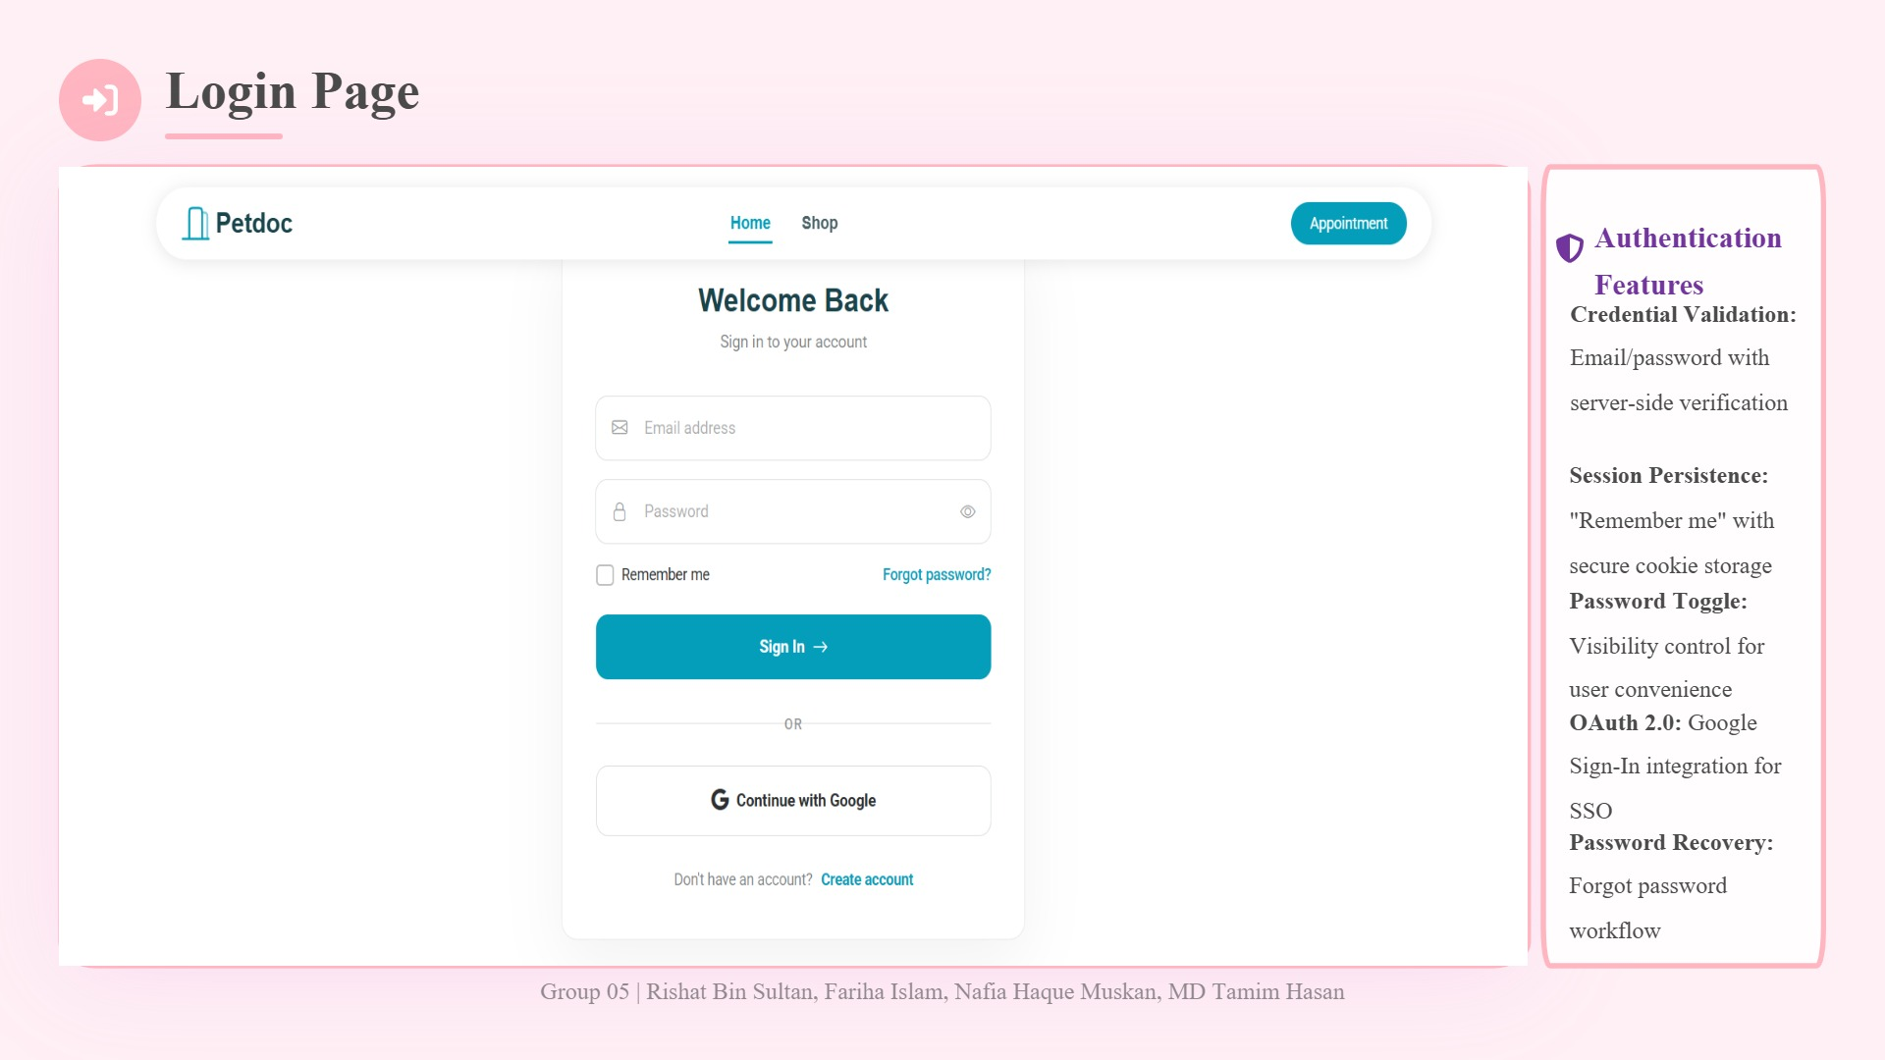

Slide 7
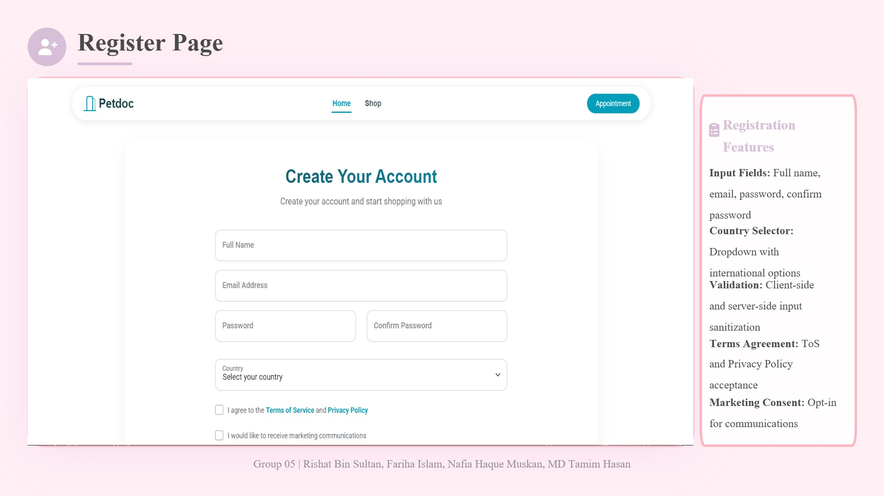

Slide 8
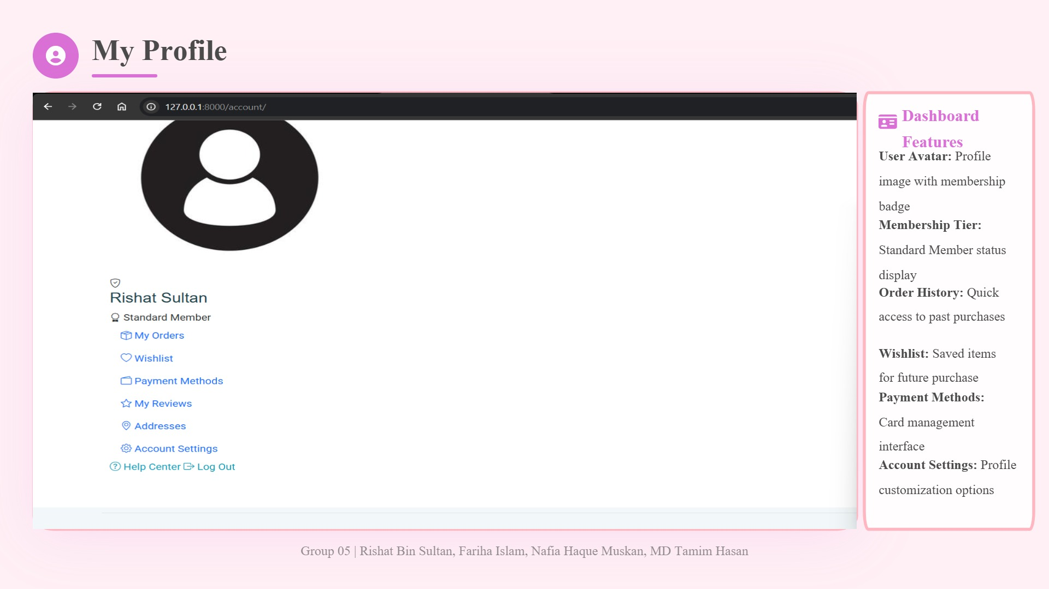

Slide 9
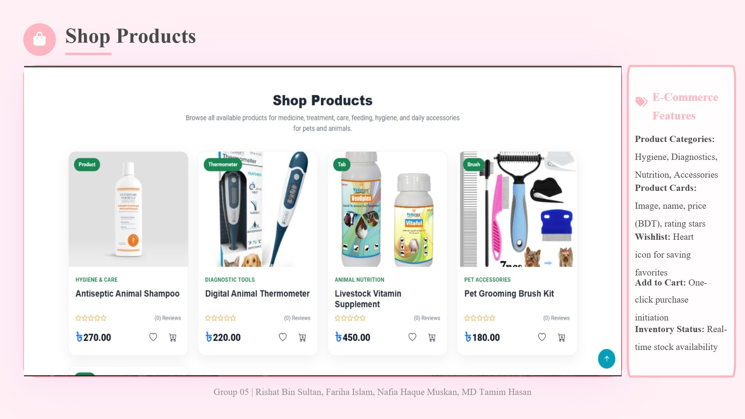

Slide 10
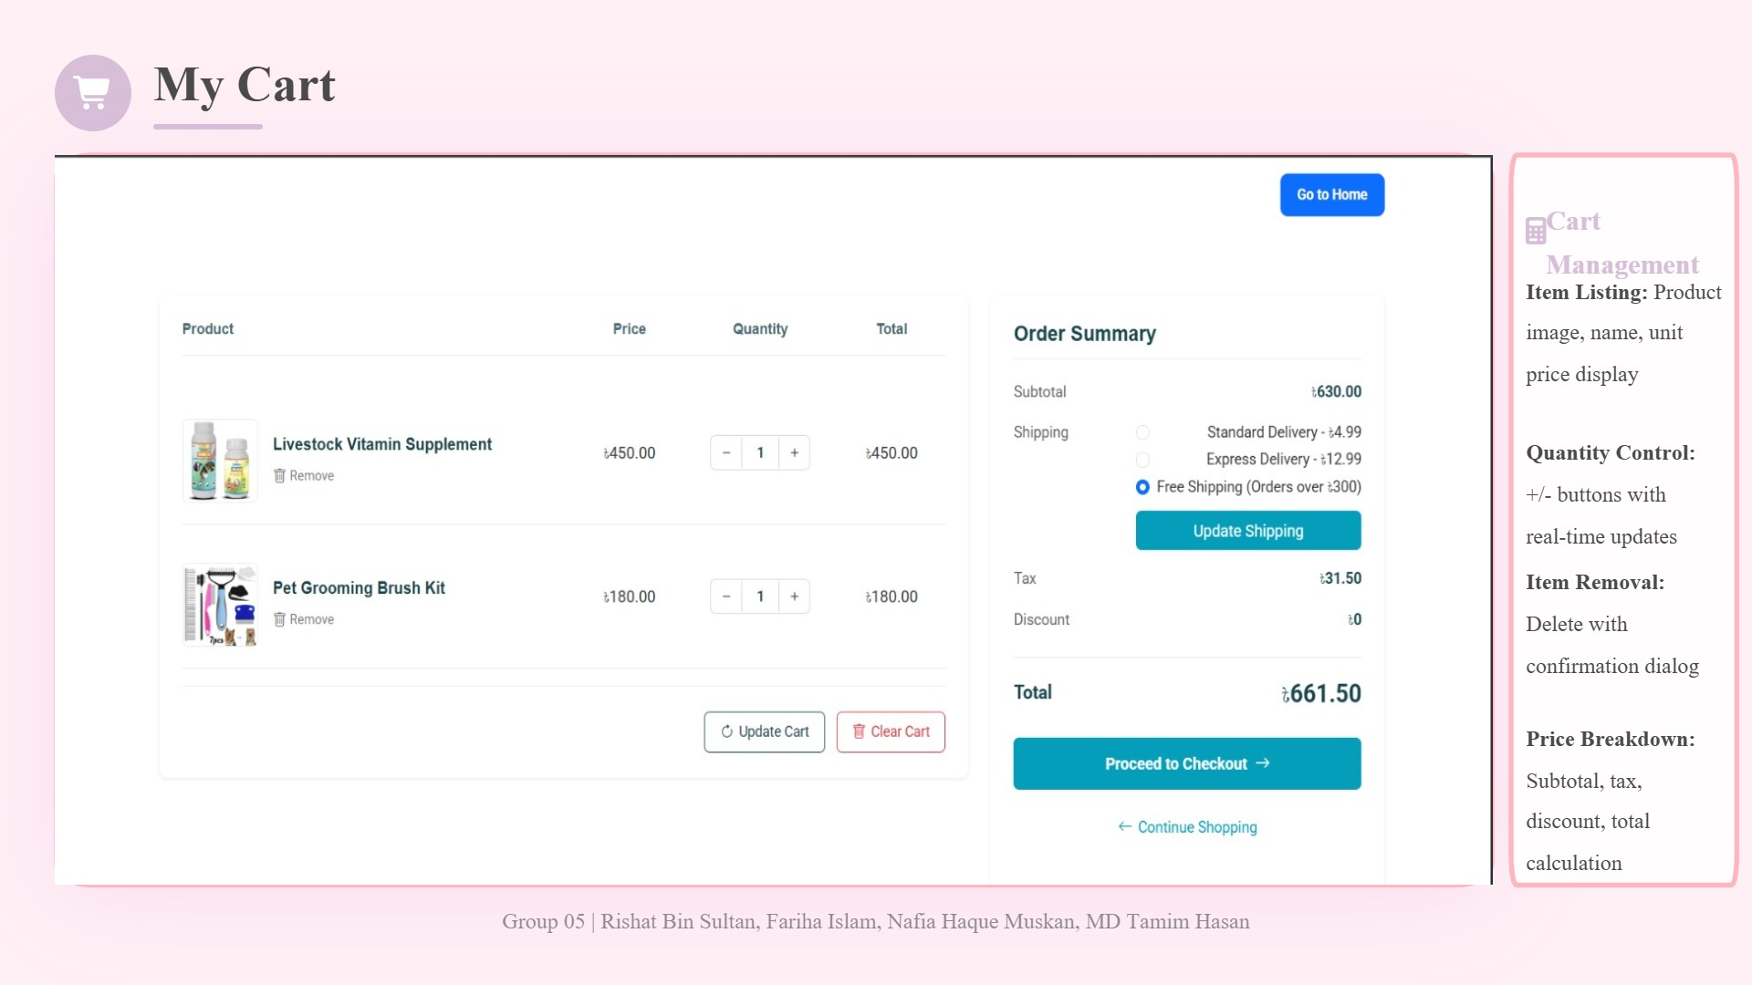

Slide 11
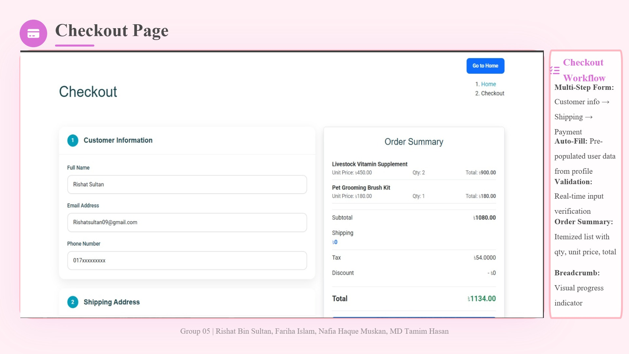

Slide 12
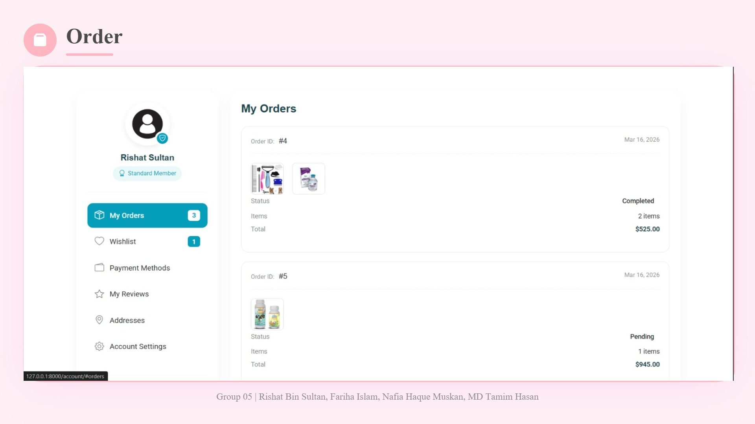

Slide 13
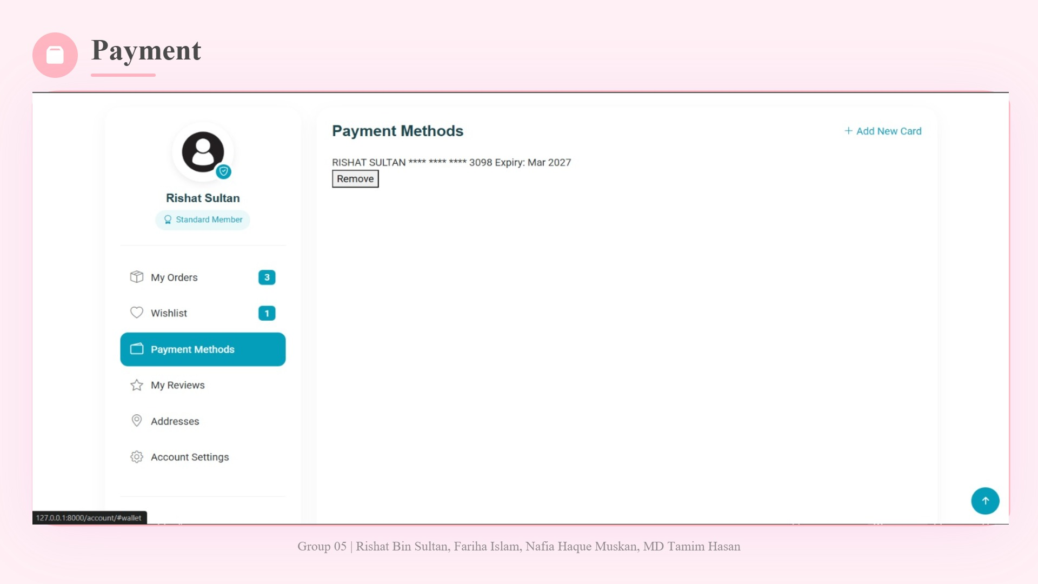

Slide 14
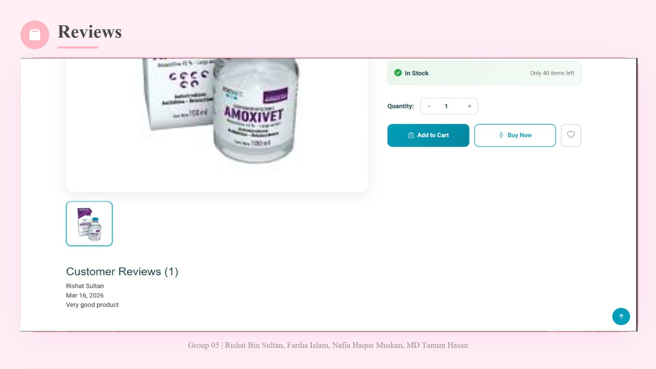

Slide 15
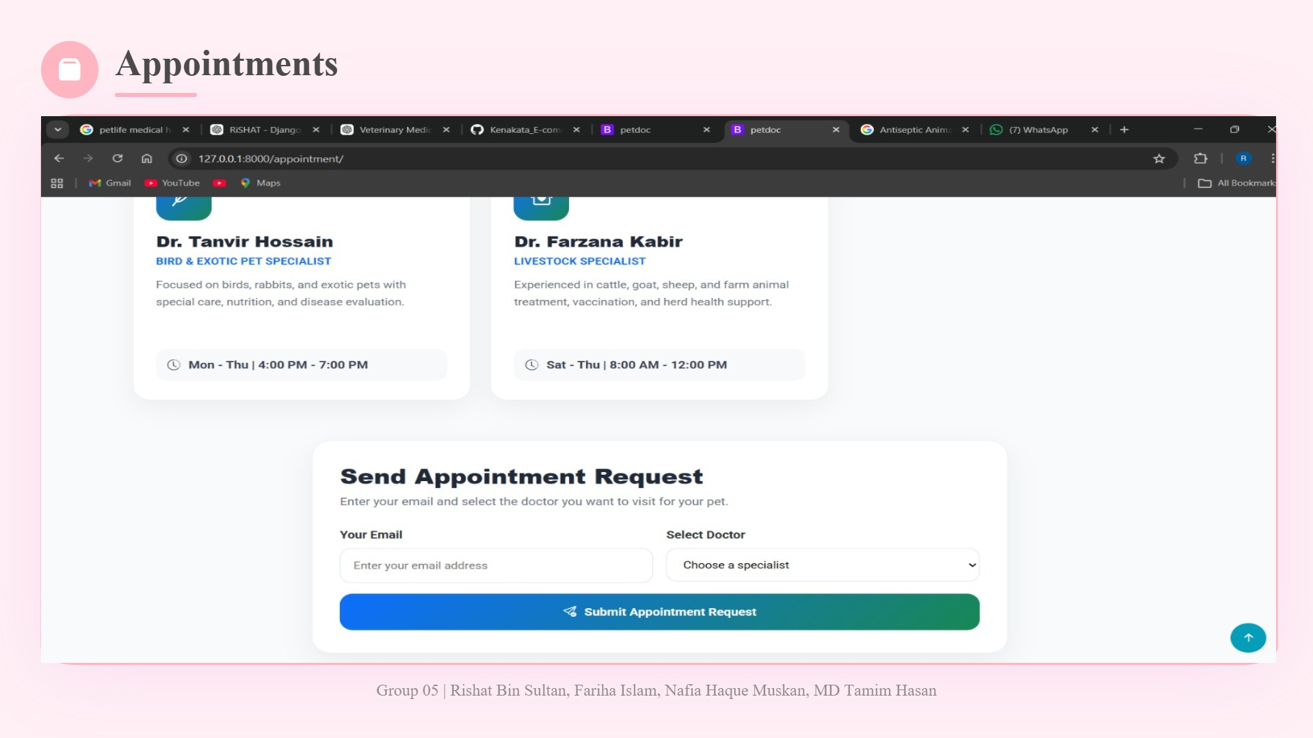

Slide 16
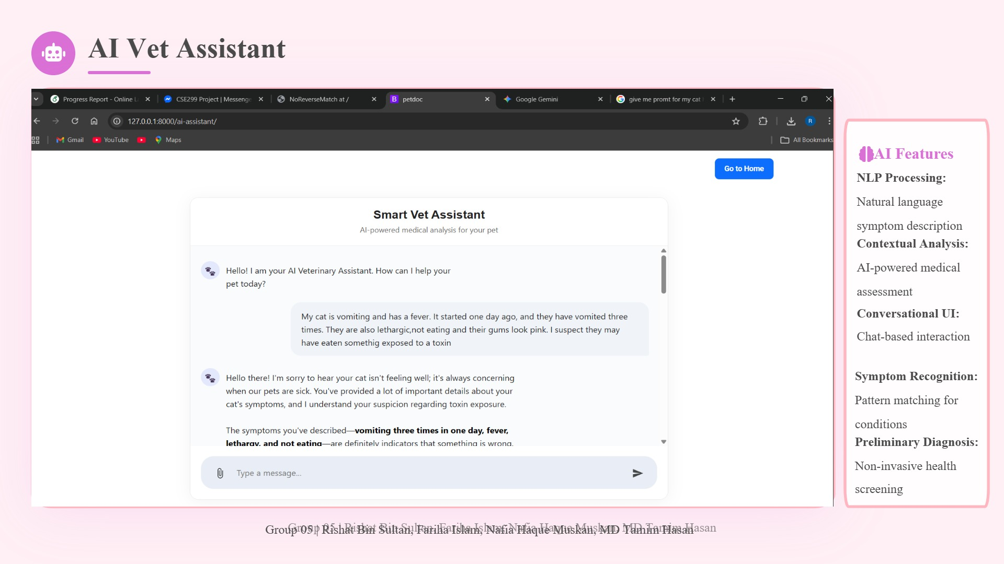

Slide 17
Admin Dashboard Configuration
VendorAdmin
CartItemAdmin
ReviewAdmin
list_display: name, email, phone, created_at, image
list_display: cart, product, quantity
list_display: product, user, rating, created_at
search_fields: name, email
WishlistAdmin
PaymentMethodAdmin
CategoryAdmin
list_display: user
list_display: user, card_name, masked_number, is_default
list_display: title, slug, image
filter_horizontal: products
search_fields: title
prepopulated_fields: slug → title
AddressAdmin
OrderAdmin
list_display: user, title, city, country, is_default
ProductAdmin
list_display: id, user, total_amount, status, created_at
list_filter: status
list_display: title, vendor, category, price, stock, label
AppointmentAdmin
list_filter: category, vendor
OrderItemAdmin
list_display: email, doctor, created_at
prepopulated_fields: slug → title
list_filter: doctor, created_at
list_display: order, product, quantity, price
search_fields: email
CartAdmin
list_display: user, created_at
Custom get_image(): format_html with 50x50 thumbnail, object-fit:cover, border-radius:5px
Group 05 | Rishat Bin Sultan, Fariha Islam, Nafia Haque Muskan, MD Tamim Hasan

Slide 18
Thank You!
PetDoc
One Platform. Complete Care. Smarter Decisions.
AI Diagnostics
E-Commerce
24/7 Consultation
Group 05
Rishat Bin Sultan, Fariha Islam, Nafia Haque Muskan, MD Tamim Hasan

